Slide 1
Solar Electricity Analysis & Battery Impact study
Tesco Analysis project
Presented by: Manu
Date: 14/04/2025

Slide 2

Project Overview
Goal
Analyse solar generation vs. electricity usage and evaluate battery impact.
Data source
PostgreSQL Database
Tools
Python(pandas, numpy, matplotlib/seaborn)

Slide 3
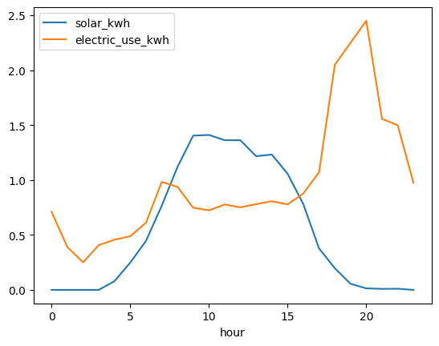
Data visualization and checks
The solar energy generation has a peak around the 12th hour, indicating strong solar power production during the middle of the day.
The electric energy usage has a more fluctuating pattern

Slide 4
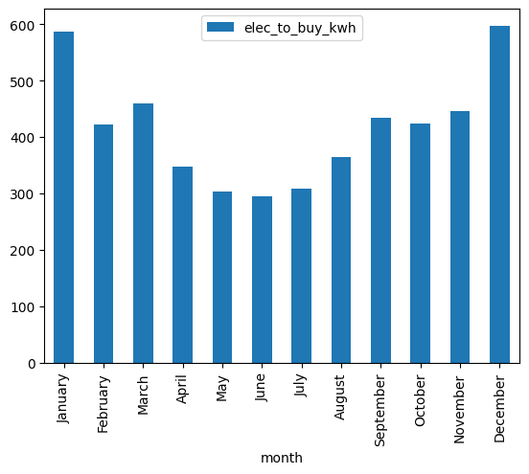
Electricity Bought (no battery)
There is a significant variation in the amount of electricity bought across different months, ranging from around 300 kwh to over 600 kwh.
The highest electricity purchase is observed in December, indicating a peak demand
The months with the lowest electricity purchase are april, may and july – relatively lower energy demand.

Slide 5
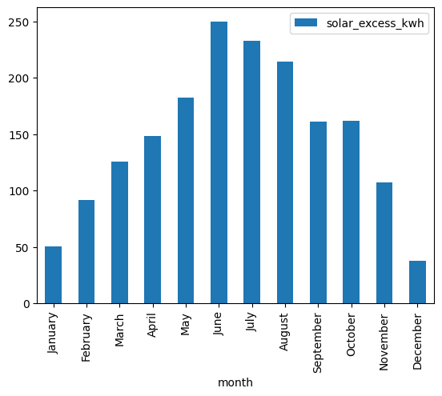
Excess solar generation
The solar energy excess is highest in june, reaching over 230 kwh.
The solar energy excess decreases in the fall and winter months, with lowest values observed in December and January.

Slide 6
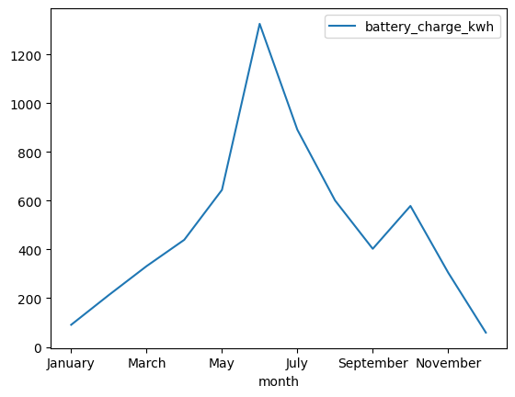
Modelling Battery charge level
The battery charge reaches its peak in june, exceeding 1,200 kwh.
The decline in battery charge during the later months could indicate higher energy usage/ lower solar power generation, resulting in the battery being drawn down to meet the demand.

Slide 7
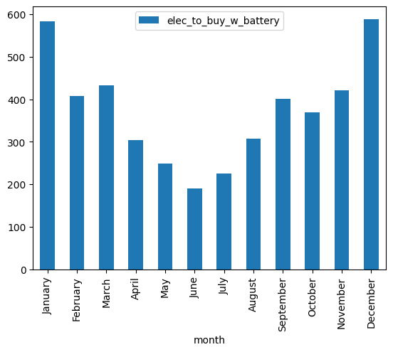
Electricity bought with battery
There is a significant fluctuation in the electricity bought with battery through the year, with peaks and valleys observed across different months
The electricity bought with battery is generally lower during the summer months, suggesting the battery system is able to meet a larger portion of the energy demand during this period.

Slide 8
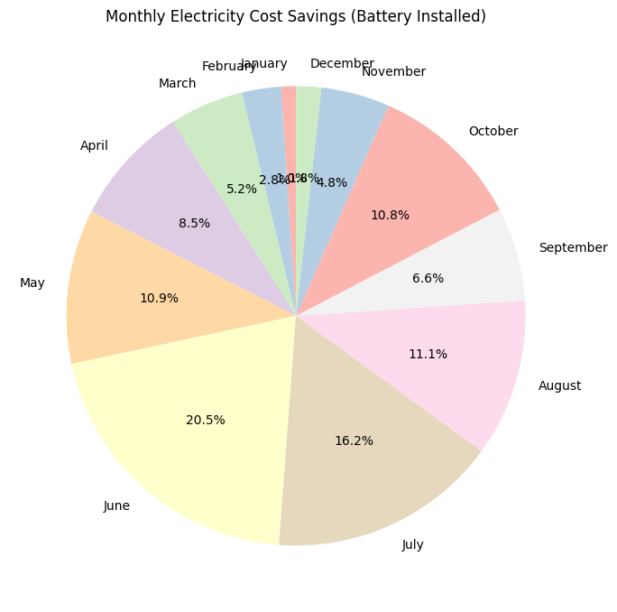
Savings
The largest cost savings are observed in June, which accounts for 20.5% of the total monthly savings
The distribution of savings across the months suggests a seasonal pattern, with higher savings during the summer months and lower savings during the spring and winter months.

Slide 9

Key insights
Most electricity is used in the evening
Peak solar generation around midday
Saving can be substantial with efficient battery use

